Slide 1
Action Recognition in Videos using Deep Learning
Deep Learning course
MSc in AI
Georgios Batsis

Slide 2
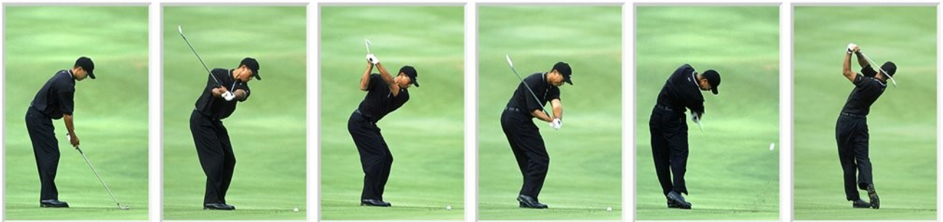
About project
Action Recognition:
Classifying the activity being performed by a human
We need a set of evidence to recognize an action → Video classification
Video:
A signal which combined spatial and temporal information
Sequence of images-frames

Slide 3
MODELS

Slide 4
Baseline
Step 1 → Feature Extraction of each frame: Texture information → GLCM features:
Contrast
Dissimilarity
Homogeneity
ASM
Energy
Correlation
Step 2 → Temporal Aggregation: Statistics → Mean & Std
Step 3 → Definition of a classifier pipeline:
Standard Scaler
SVM with RBF Kernel

Slide 5
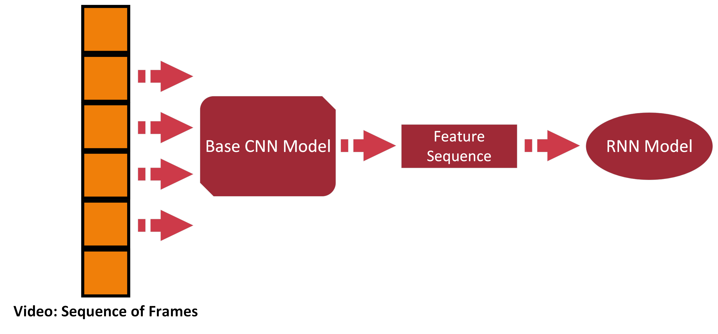
Going Deeper…

Slide 6
Experiments: Step 1 → Choose Base CNN Model
Most popular pretrained models:
VGG
ResNet
MobileNet.
Choose which layers will be left frozen:
CNNs consist of:
Convolutional Block → Convolutional and Pooling Layers
Classifier → Fully Connected Layers
Freezing options:
Last (or other) Convolutional Layer
Penultimate Layer of classifier

Slide 7
Experiments: Step 2 → Deep Model Construction
Define the RNN-based part:
Model (e.g. LSTM)
Hidden state dimension
Number of layers
Direction
Final classifier
After pre-trained CNN selection, decide if:
Use the extracted features directly
Add trainable layer(s) after feature extraction

Slide 8
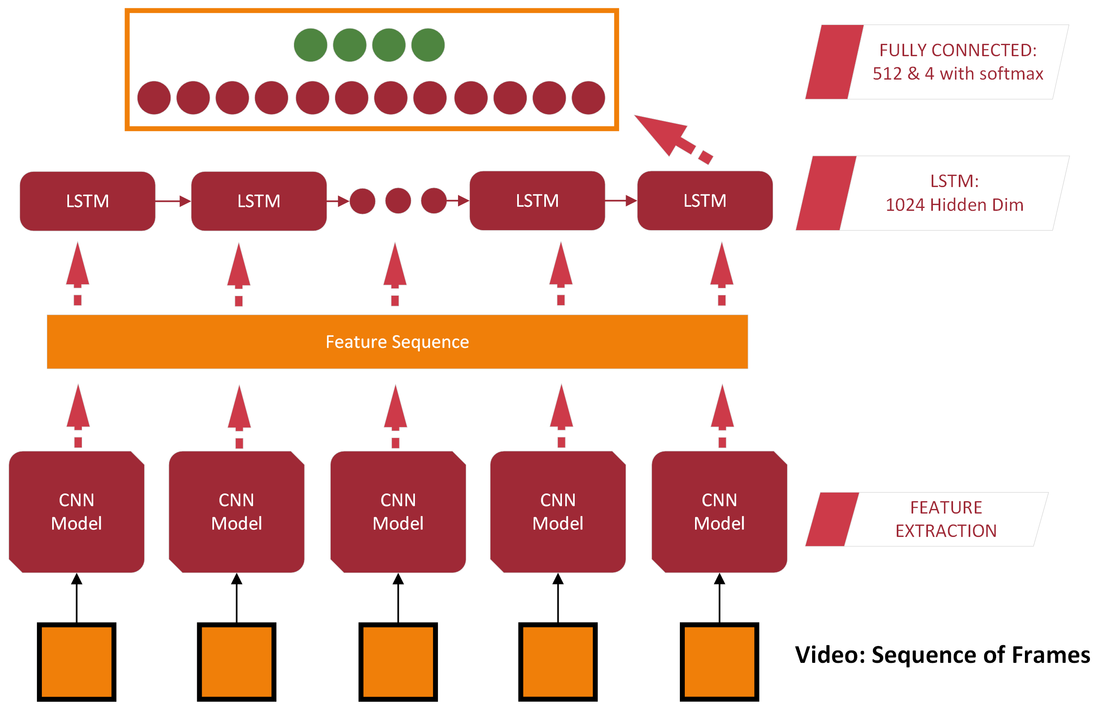
Approach A

Slide 9
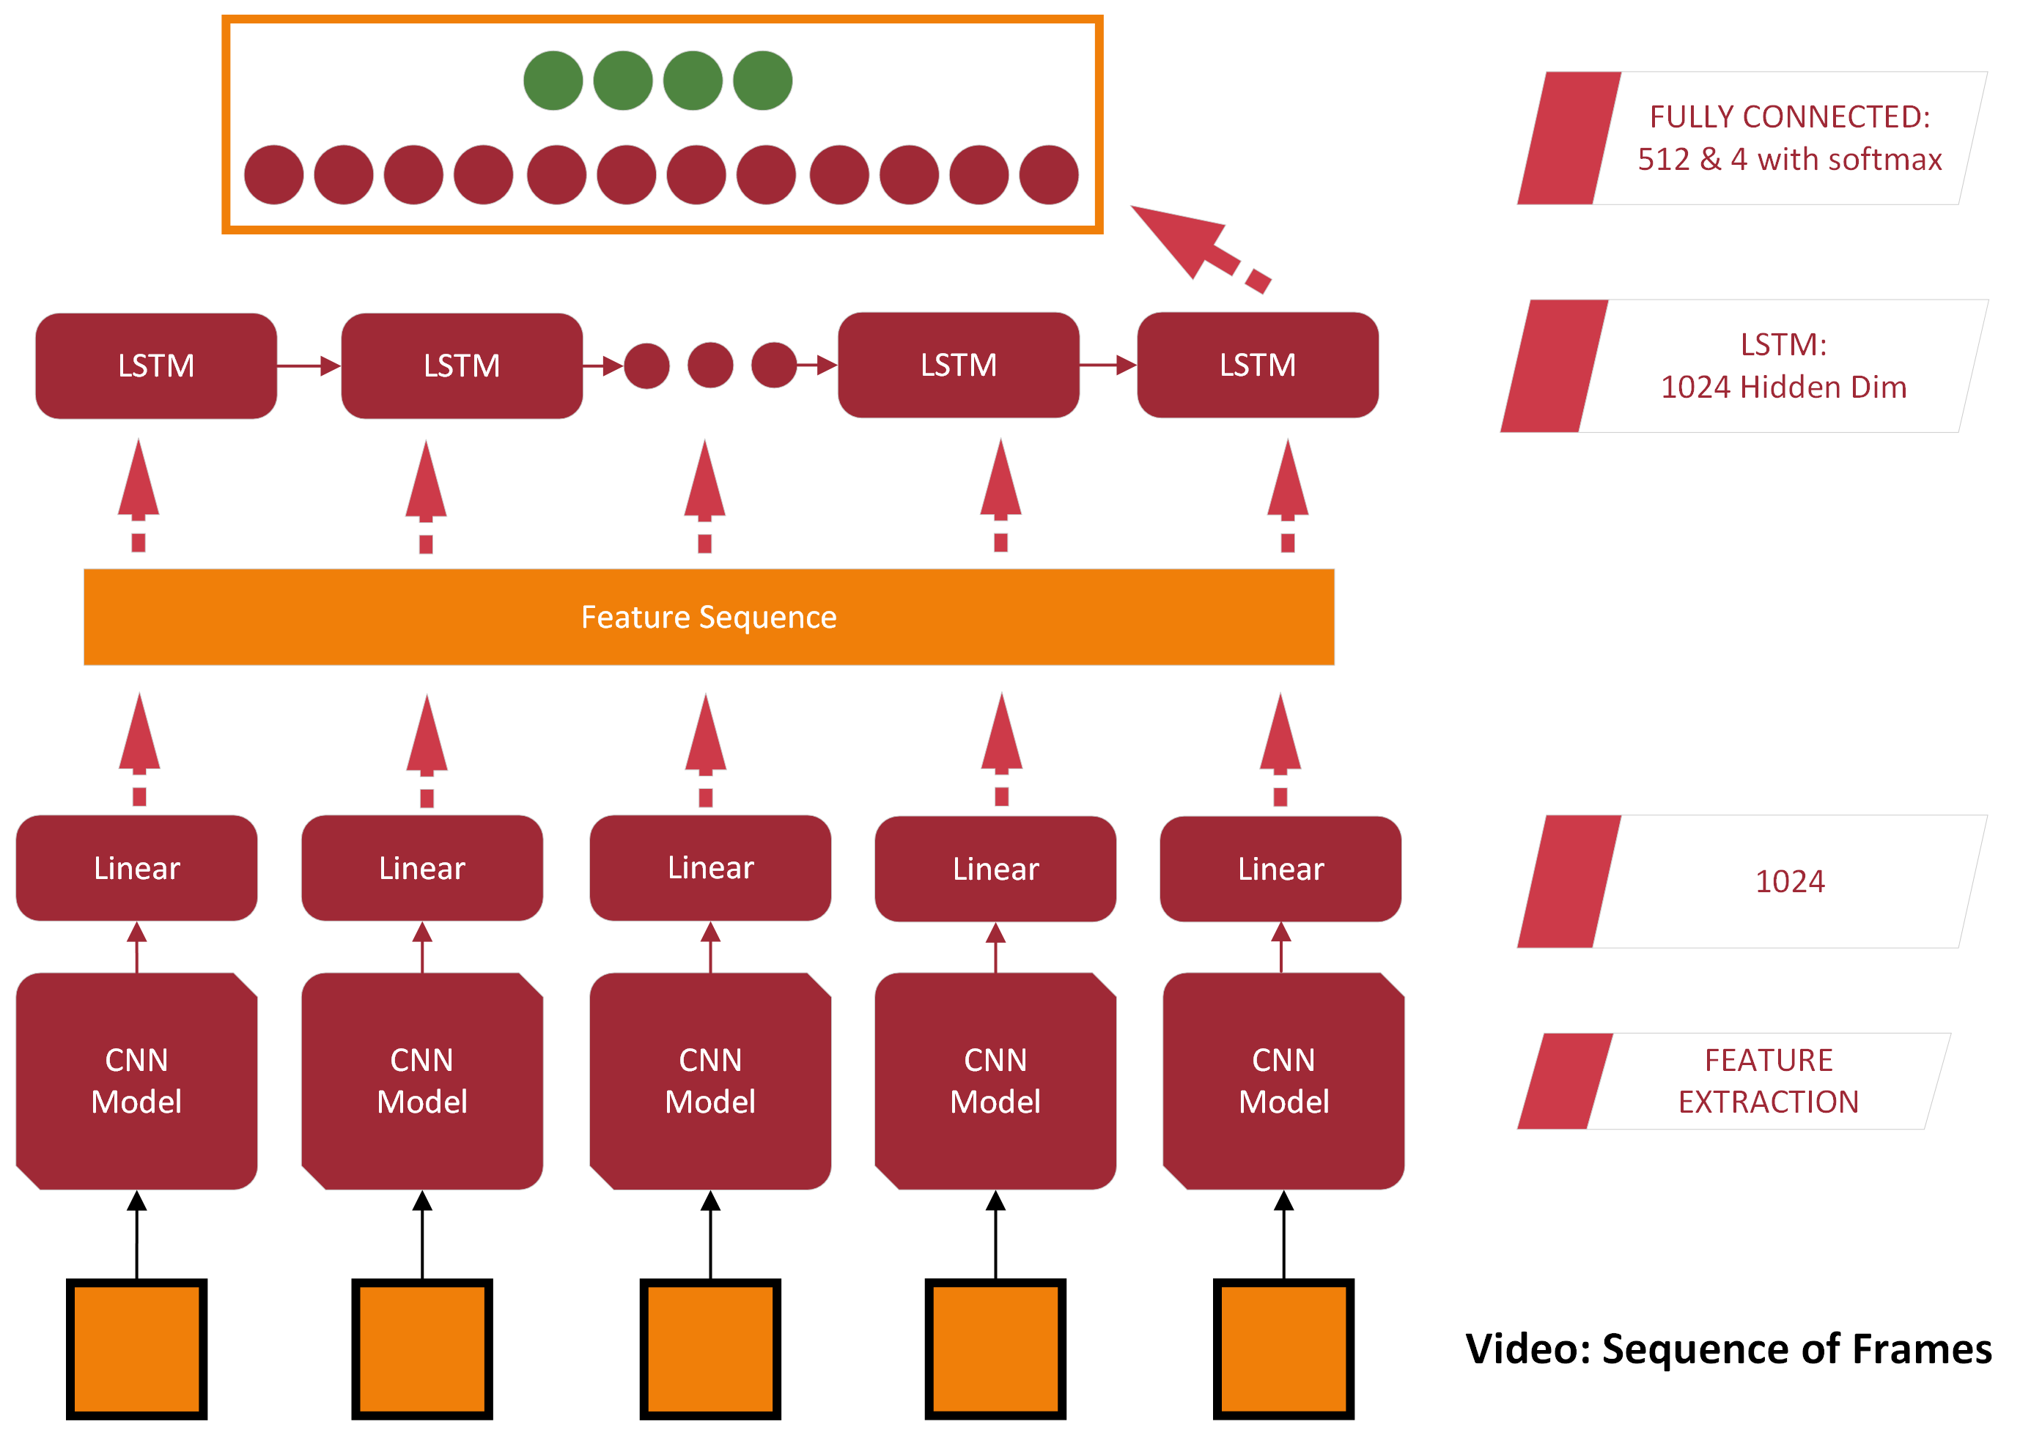
Approach B

Slide 10
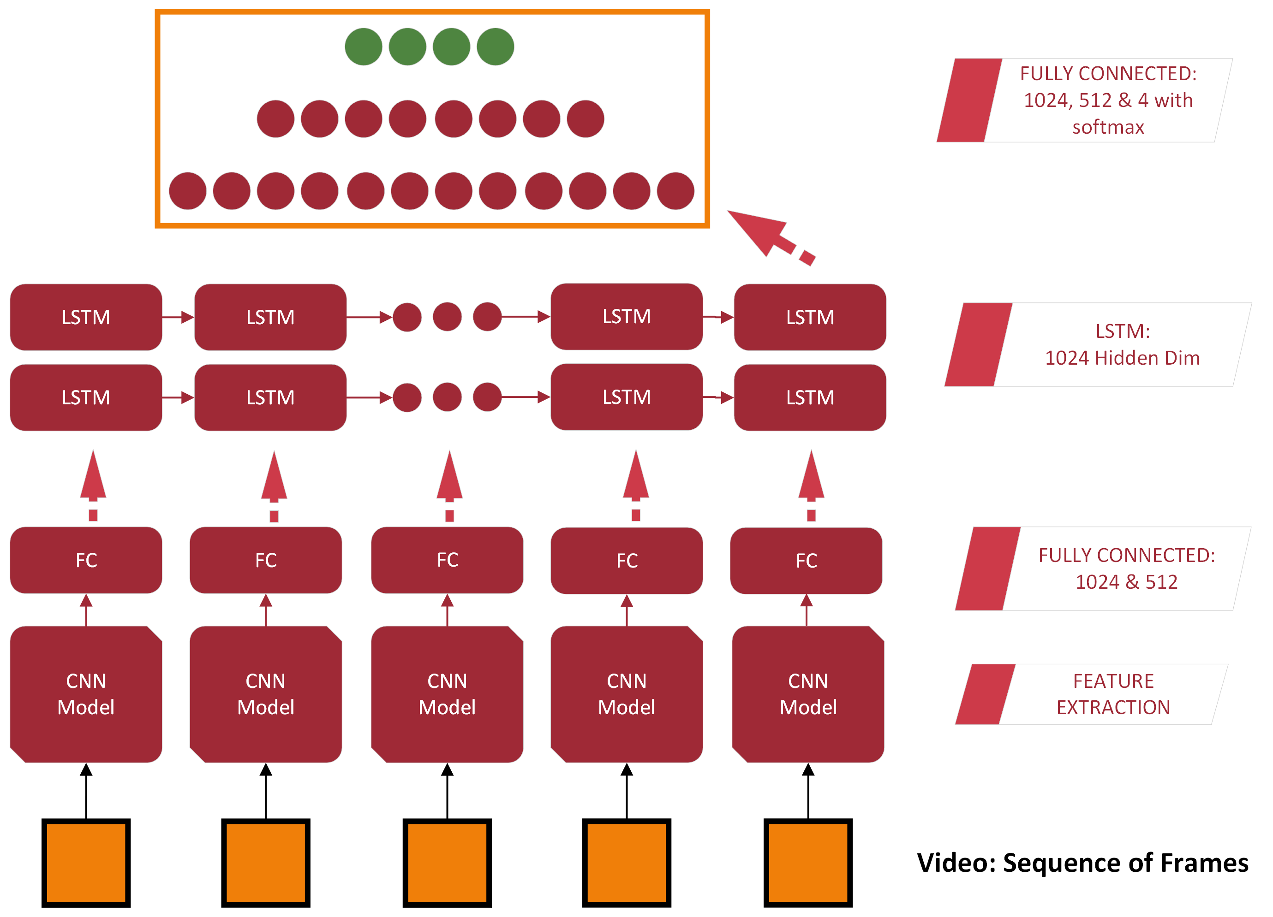
Approach C

Slide 11
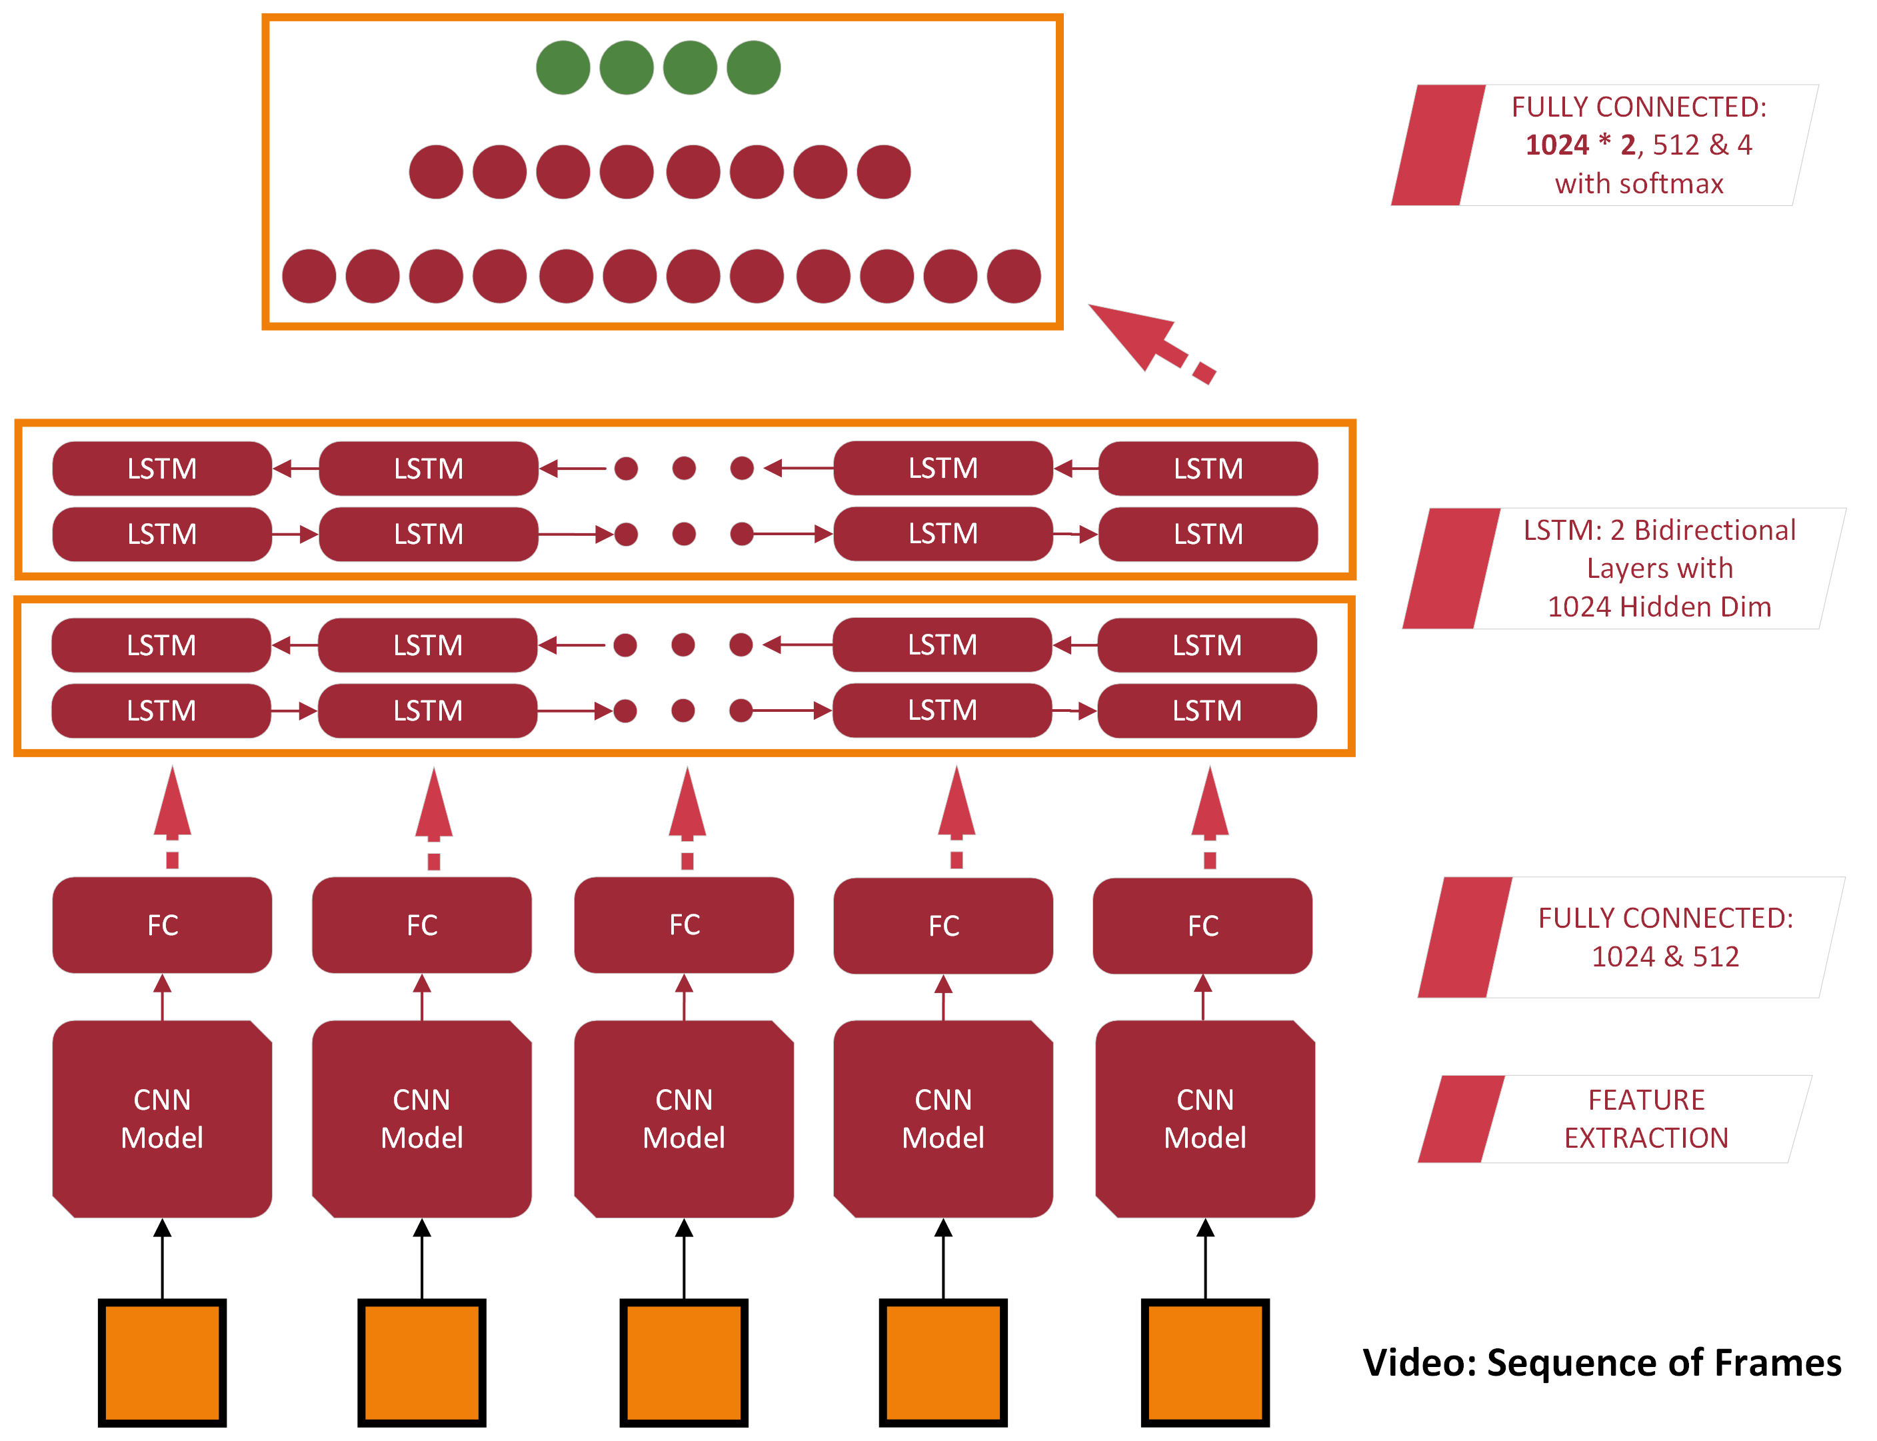
Approach C’

Slide 12
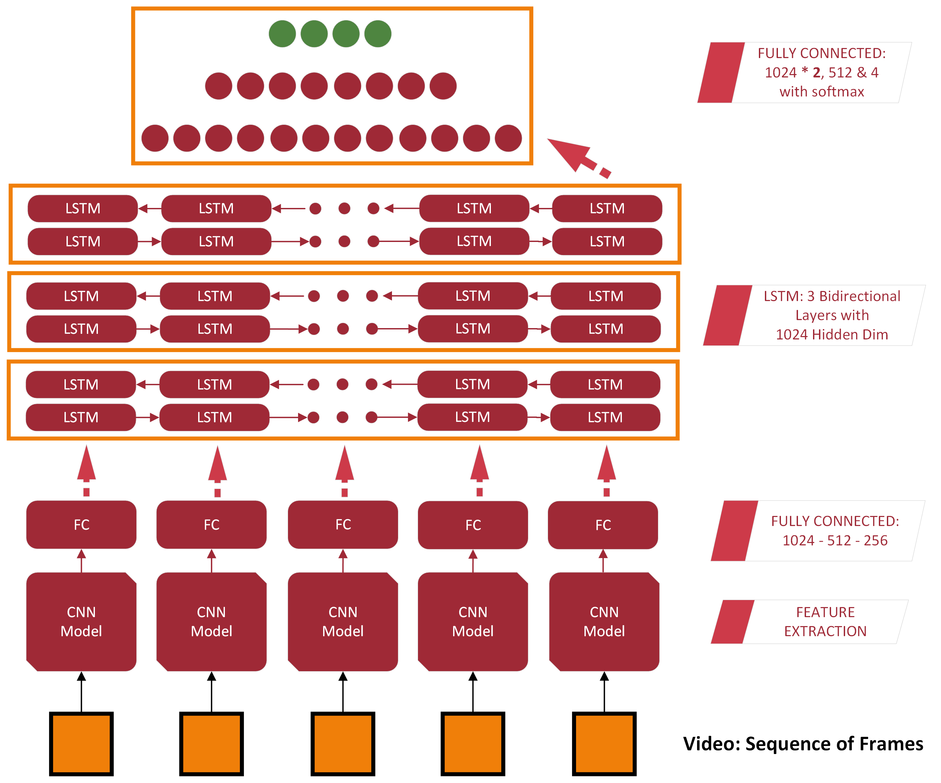
Approach D

Slide 13
RESULTS

Slide 14
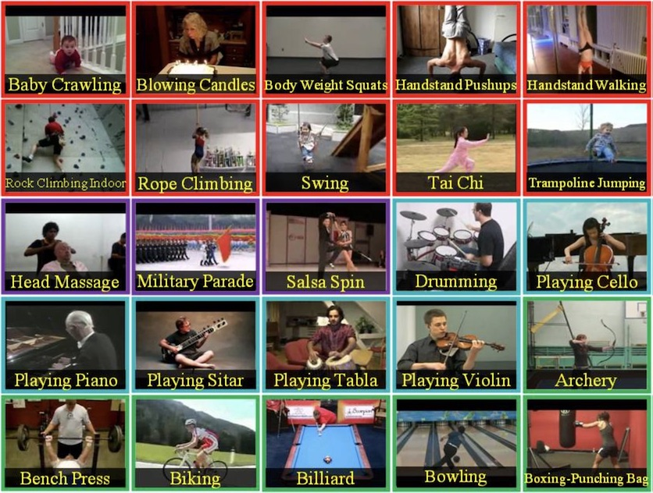
Dataset
UCF101 Human Actions dataset:
A small subset was used in this project
Official train-test splitting
Classes:
0: Playing Guitar
1: Rock Climbing Indoor
2: Soccer Juggling
3: Band Marching

Slide 15
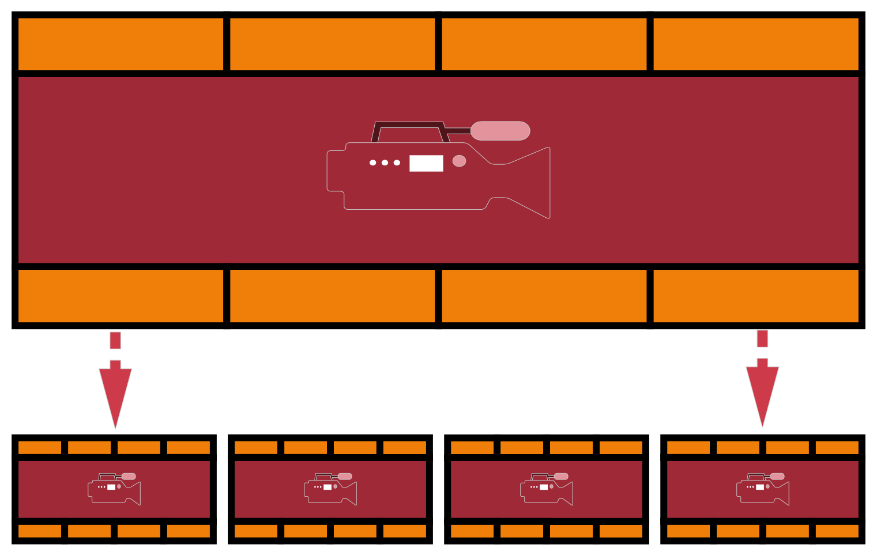
Preprocessing
Sequence level transformation:
Problem: Differences in the total number of frames per video & the Fps
Solution: Extract video segments → Shorter videos with fixed number of frames
Frame-level transformation:
Resize (e.g. 224x224)
Normalize → mean=[0.485, 0.456, 0.406], std=[0.229, 0.224, 0.225]

Slide 16
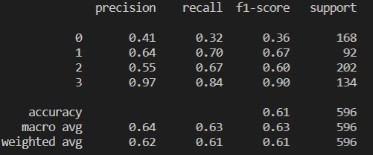
Results: Baseline
True\Predicted | 0 | 1 | 2 | 4
0 | 54 | 28 | 82 | 4
1 | 17 | 63 | 12 | 0
2 | 59 | 8 | 135 | 0
3 | 4 | 0 | 18 | 112

Slide 17
Results
Pre-trained CNN selection:
All models tested using the DNN of Approach A
ResNet – 125 freezed at the last Convolutional Layer (we receive output of Average Pooling) outperforms VGG 19 freezed at the penultimate Layer of classifier [87.8% vs 83.4% F1 Score in validation dataset].
If we freeze the last Convolutional Layer of VGG the model can’t learn…
MobileNet overfits…

Slide 18
Results
Model Name | F1 Score | Loss
Approach A | 87.8 | 2.9
Approach B | 97.7 | 0.64
Approach C | 98.4 | 0.44
Approach C (Bid) | 97.7 | 0.57
Approach D | 98.6 | 0.29

Slide 19
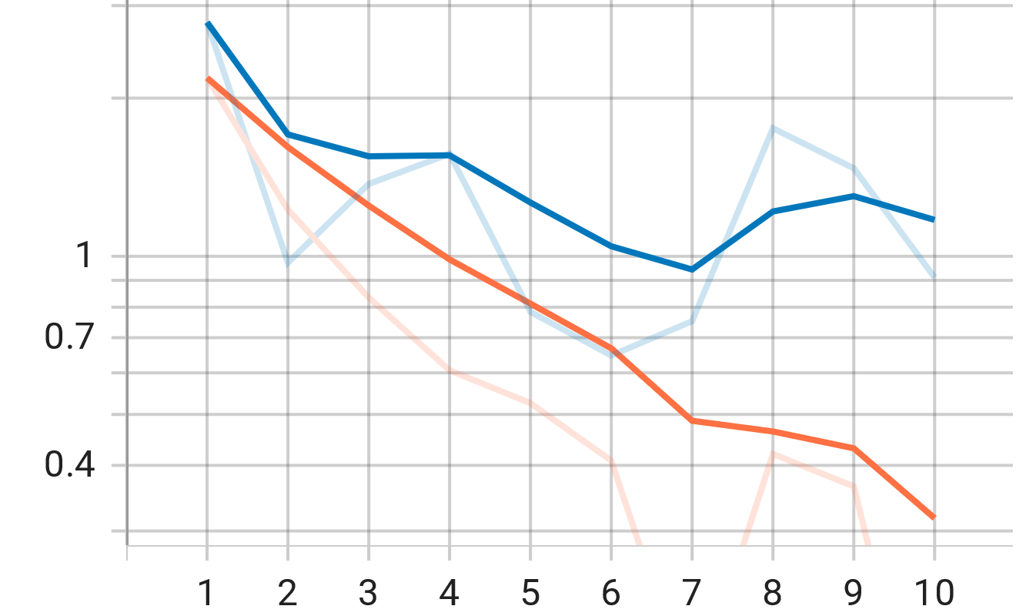
Results
LOSS
Model Name | F1 Score | Loss
Approach A | 87.8 | 2.9
Approach B | 97.7 | 0.64
Approach C | 98.4 | 0.44
Approach C (Bid) | 97.7 | 0.57
Approach D | 98.6 | 0.29

Slide 20
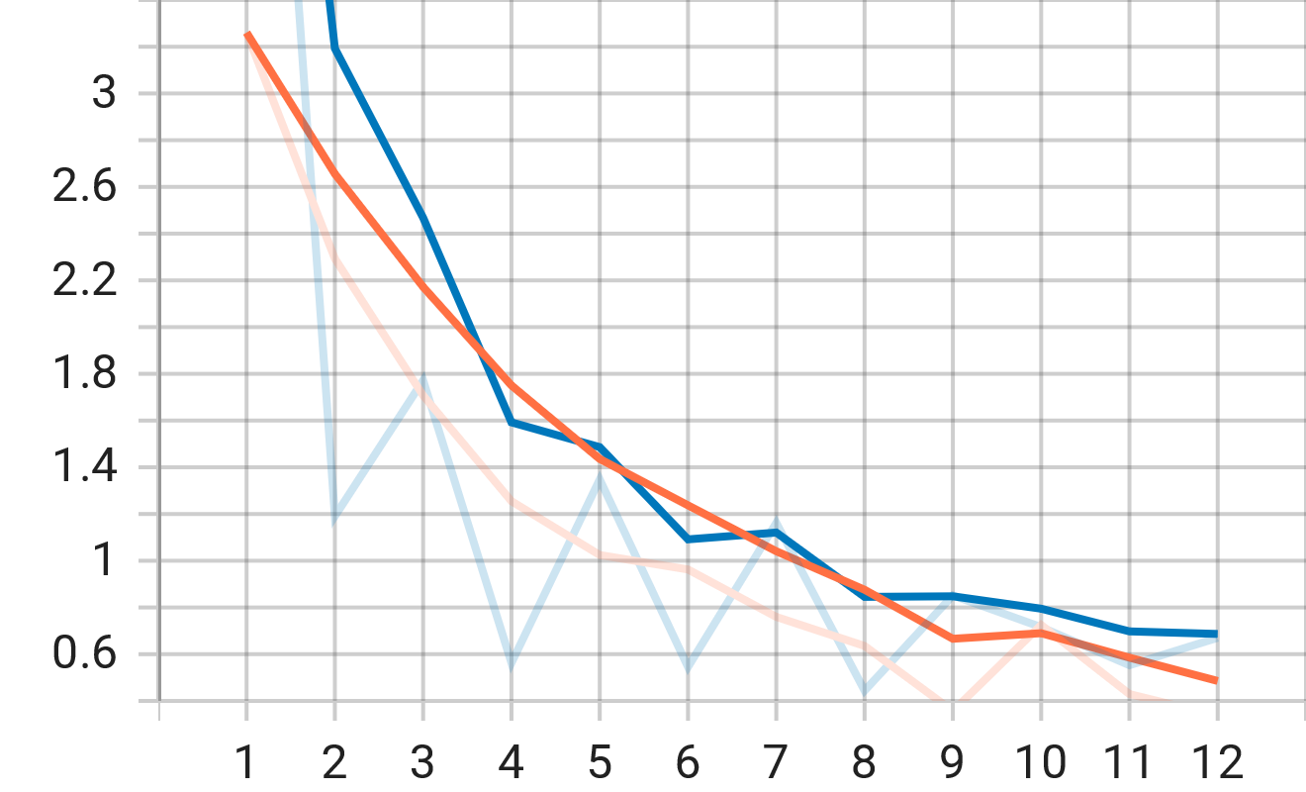
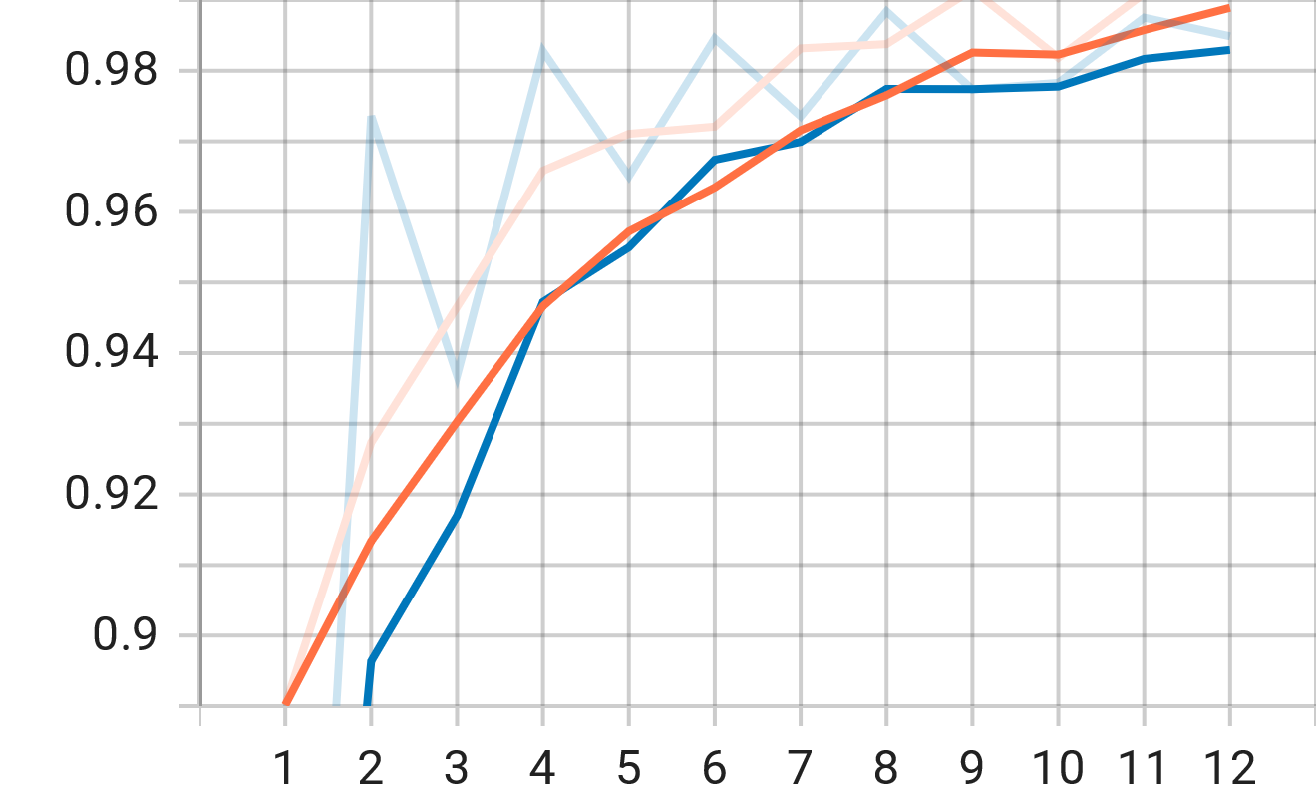
Results
LOSS
Model Name | F1 Score | Loss
Approach A | 87.8 | 2.9
Approach B | 97.7 | 0.64
Approach C | 98.4 | 0.44
Approach C (Bid) | 97.7 | 0.57
Approach D | 98.6 | 0.29
F1

Slide 21
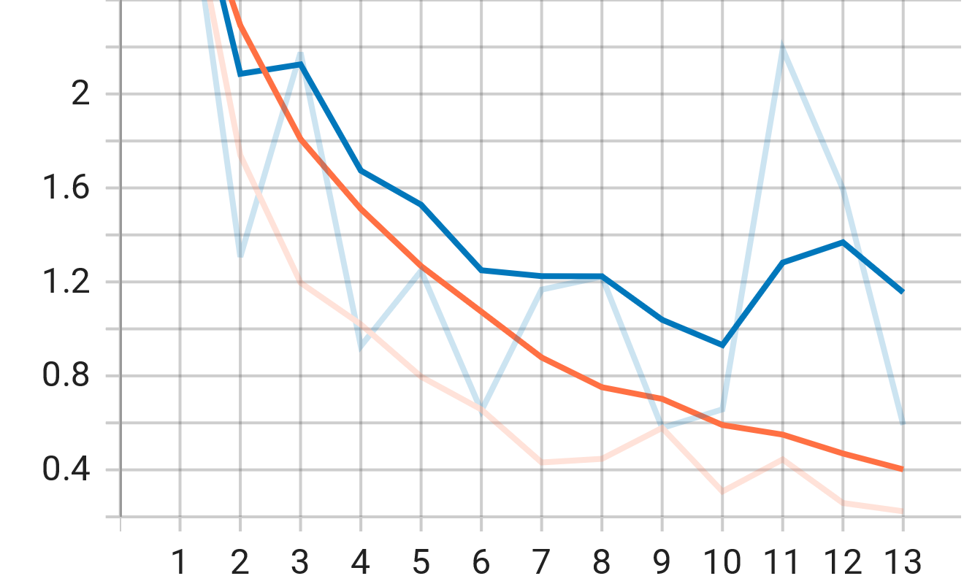
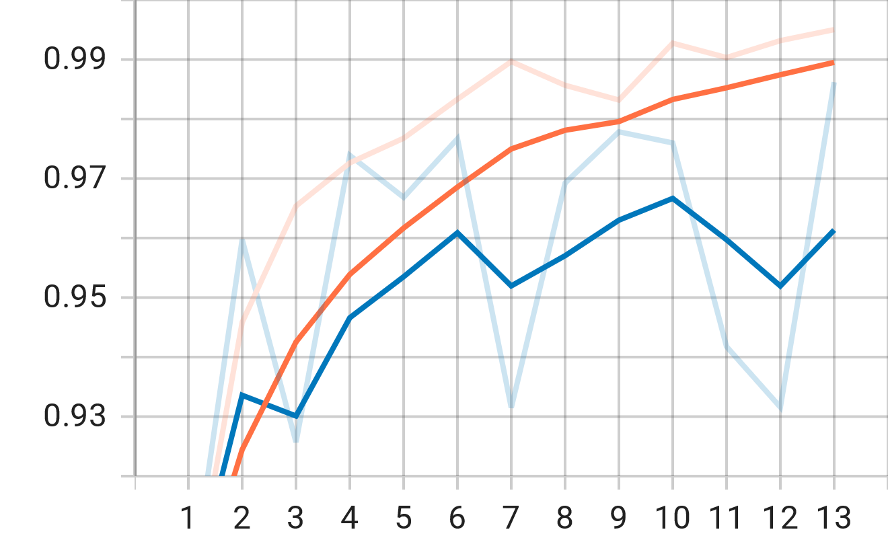
Results
LOSS
Model Name | F1 Score | Loss
Approach A | 87.8 | 2.9
Approach B | 97.7 | 0.64
Approach C | 98.4 | 0.44
Approach C (Bid) | 97.7 | 0.57
Approach D | 98.6 | 0.29
F1

Slide 22
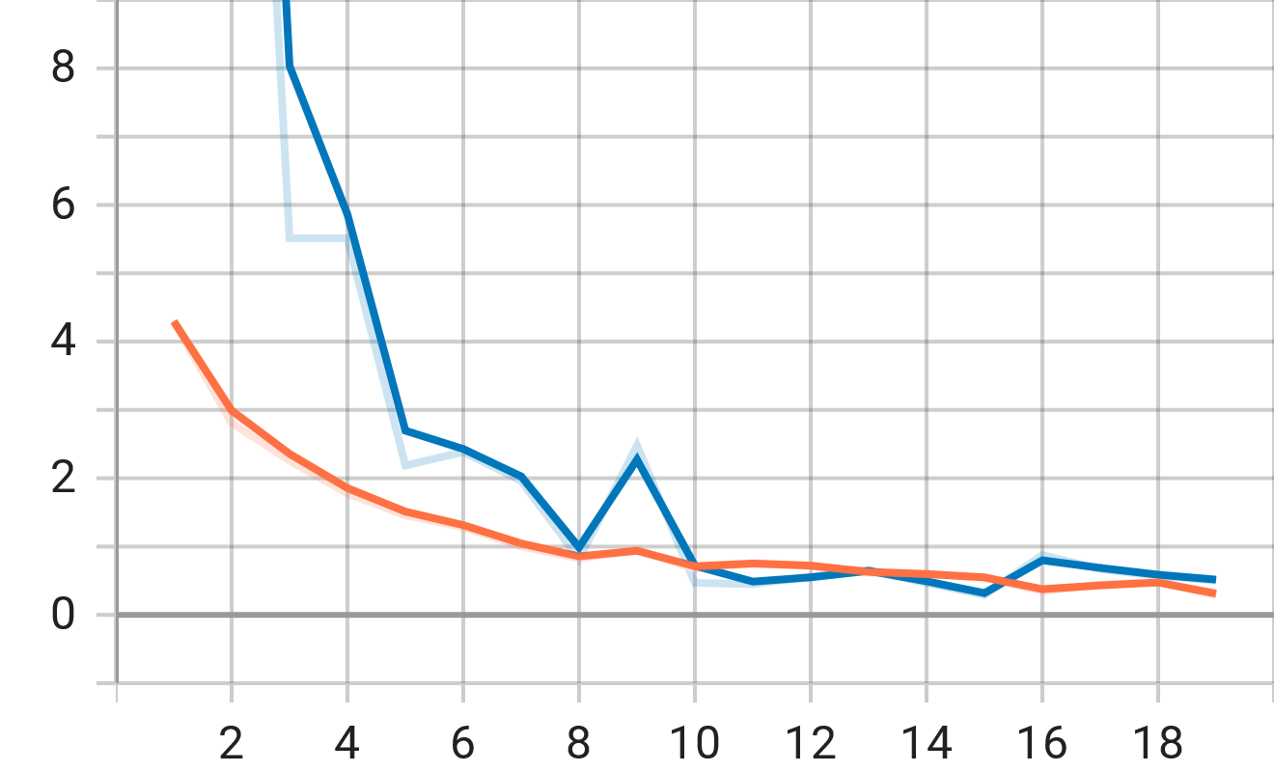
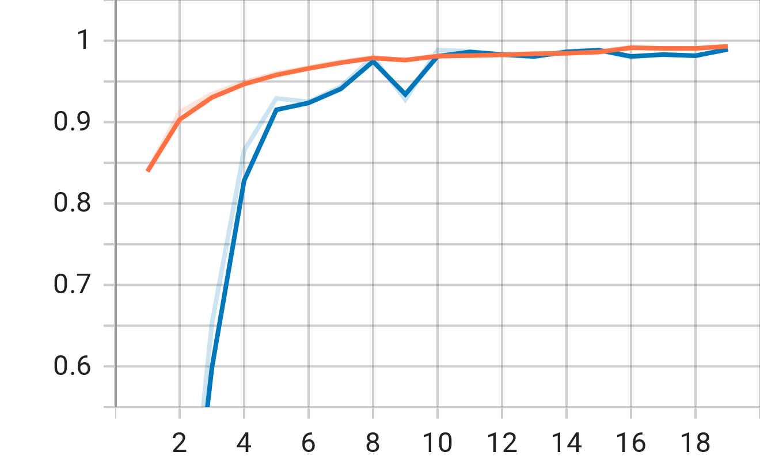
Results
LOSS
Model Name | F1 Score | Loss
Approach A | 87.8 | 2.9
Approach B | 97.7 | 0.64
Approach C | 98.4 | 0.44
Approach C (Bid) | 97.7 | 0.57
Approach D | 98.6 | 0.29
F1

Slide 23
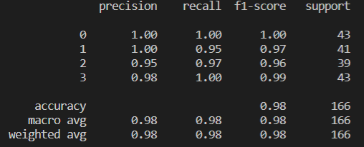
Results: Approach C & Test Dataset
True\Predicted | 0 | 1 | 2 | 4
0 | 43 | 0 | 0 | 0
1 | 0 | 39 | 2 | 0
2 | 0 | 0 | 38 | 1
3 | 0 | 0 | 0 | 43
Video level classification → Combine predictions of all segments.

Slide 24
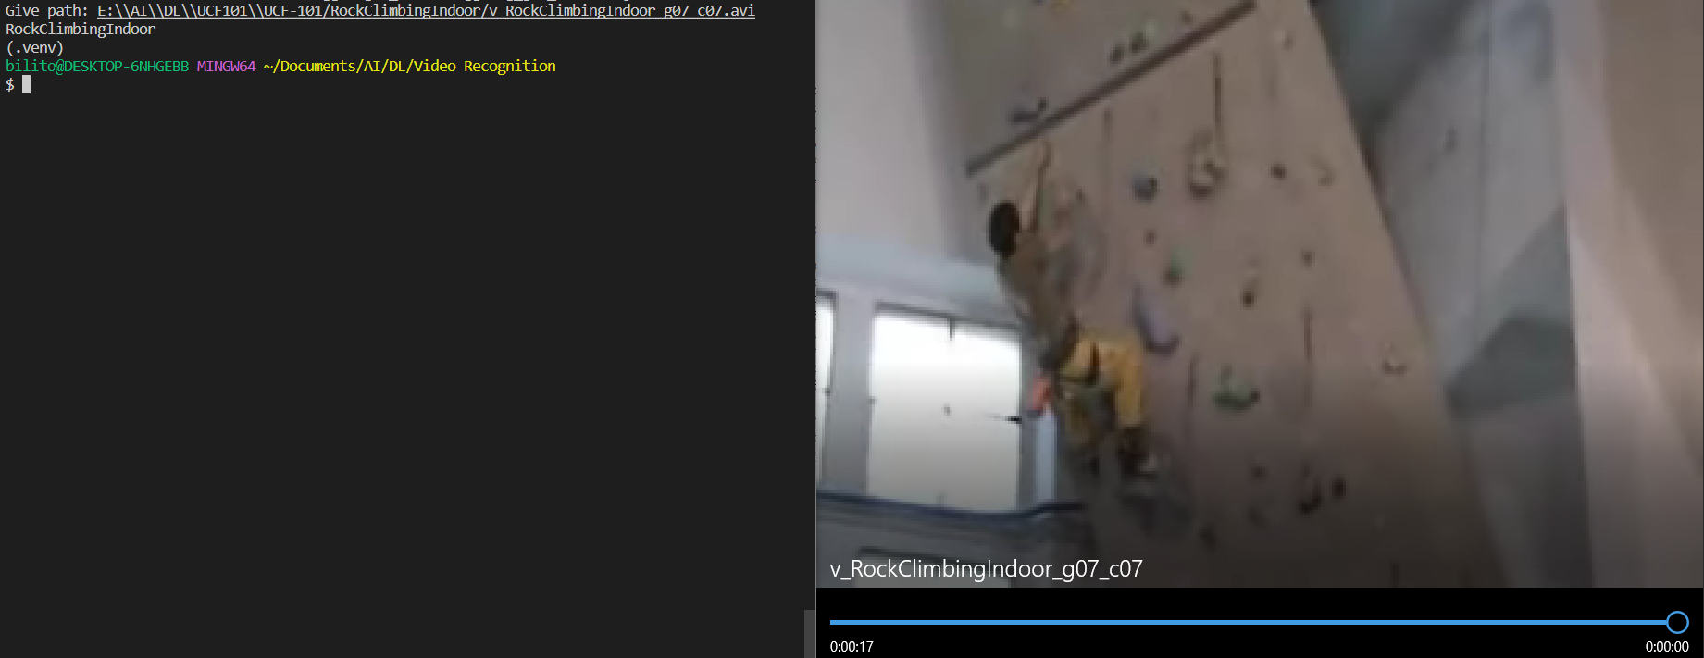
DEMO

Slide 25
Thank you!

